Slide 1

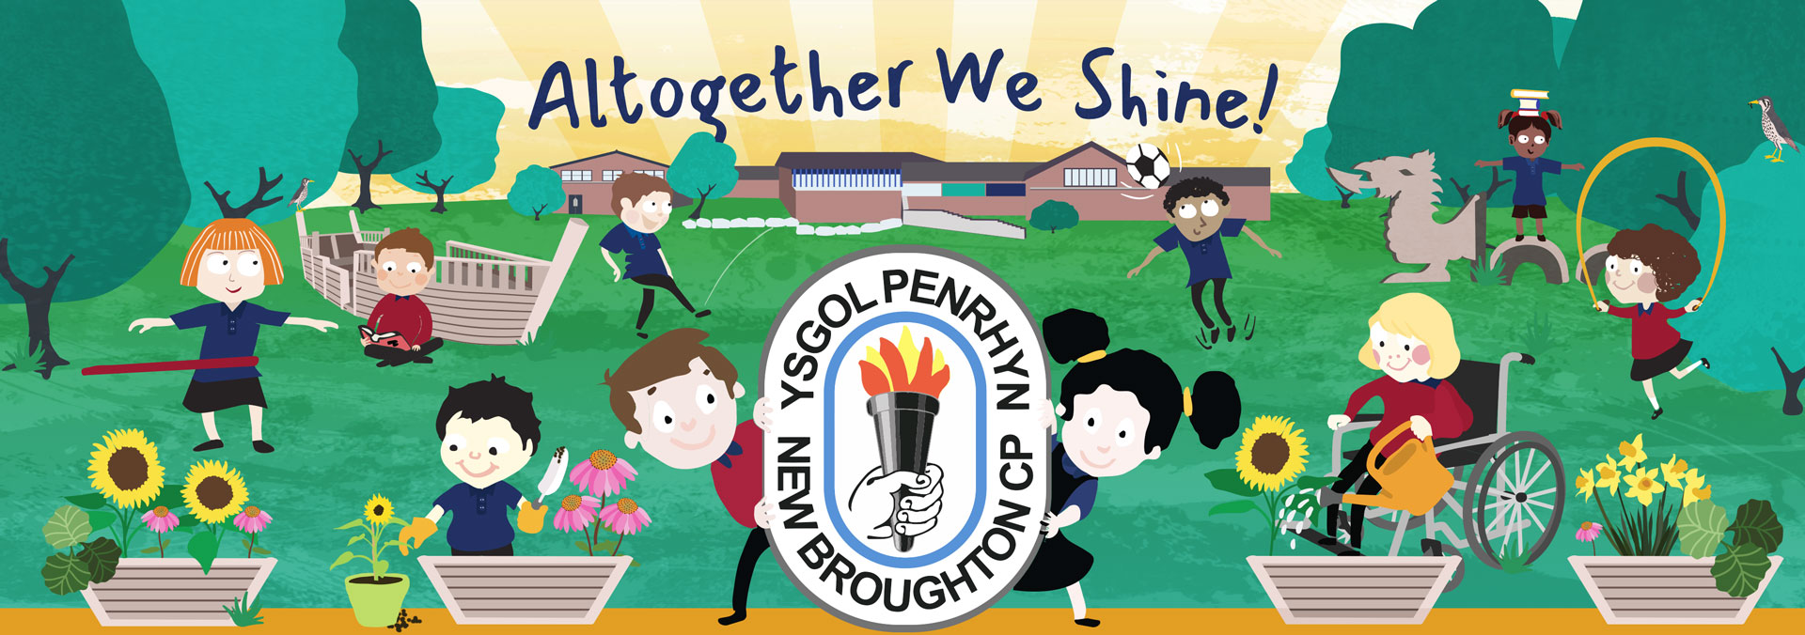
Our Vision and Values have been created together with our learners, staff, parents and Governors.
Ysgol Penrhyn celebrate and appreciate the Welsh language, culture and heritage during their time in school,
Our Vision
To create a safe, secure, happy and caring environment in which the children can grow and learn.
To recognise all children as individuals and motivate them to reach their full potential.
To work in partnership with families, Governors and local community, resulting in our children being confident, resilient and challenged to achieve their aspirations.
To provide our children with real life experiences and skills, equipping them with the confidence to face and overcome challenges to enjoy learning every day.
Values
Be kind and caring
Be happy and enthusiastic
Be creative and curious
Be honest and respectful
Be the best you can be

Slide 2

School Context
Our school strengths:
Leaders and staff provide high levels of care and support for pupils across the school.
We are a happy, inclusive school that places high priority on pupils’ and staff well-being.
Excellent at communicating with families and the community.
Staff set high expectations for pupils’ behaviour, nearly all pupils behave well and show mutual respect for each other.
We have a developed knowledge rich curriculum which supports pupils to become curious learners, who are well acquainted with their local community.
Pupils are friendly and kind to each other, having positive attitudes to learning.
Staff recognise the needs of every pupil and provide support that meets pupils needs successfully.
Staff use Forest School particularly well to provide beneficial opportunities for all pupils to enrich their learning, including those with emotional needs.
Pupils make good progress in their well-being and learning across the curriculum. Most pupils make strong progress in their writing skills and nearly all develop a love of reading.
Staff make good use of educational and residential visits to further enrich learning experiences.
Ysgol Penrhyn is proud to provide a safe, nurturing environment where all our learners can fulfil their maximum potential. We strive to give our learners real life learning opportunities, where they can improve their skills above and beyond their expectations, equipping them to realise there is a world of opportunities available to them.
Leaders, governors and staff work together diligently to ensure the school vision “Altogether we shine” is a lived experience that supports everyone to achieve more than they ever thought possible.

Slide 3

Progress against last year’s priorities 2025-26
Priority 1: To ensure that monitoring, evaluation and improvement processes focus sharply on the aspects in most need of improvement.
The school has maintained a clear focus on its key School Development Plan (SDP) priorities, with action plans being regularly reviewed, updated and evaluated throughout the year. This has supported a more strategic approach to school improvement and ensured that priorities remained responsive to emerging needs.
Termly scrutiny activities involving the School Improvement Adviser (SIA) and Senior Leadership Team have provided valuable external challenge and supported robust self-evaluation processes. These reviews identified highly effective progression in extended writing across the school.
Regular Listening to Learners activities have provided valuable first-hand evidence about learners' experiences and progress. This has informed ongoing evaluation and contributed to continuous refinement of teaching and learning practices in line with Curriculum for Wales principles.
Priority 2: To strengthen curriculum planning and provision to support pupils to develop their skills progressively overtime
Teachers used the handbook during joint PPA sessions to support curriculum planning and monitor skills coverage. A whole-school culture of purposeful skills progression is beginning to be embedded, supporting the expectations of Curriculum for Wales.
Learner voice was gathered and used to inform topic planning, ensuring learning reflected learners' interests and needs.
Learning walks identified increasing opportunities for learners to apply LLC and M&N skills across authentic curriculum contexts.
Staff professional discussions focused on securing progression in skills development rather than repetition.
Working walls were embedded within classrooms and used by learners to support independent learning.

Slide 4

School Priorities 2026-27
Ensure that monitoring, evaluation and improvement processes focus sharply on the aspects in most need of development
Improve provision in maths through strengthening the planning for skills development, progression and challenge for all learners
Professionally develop all staff to further strengthen appropriate provision for all learners

