Slide 1

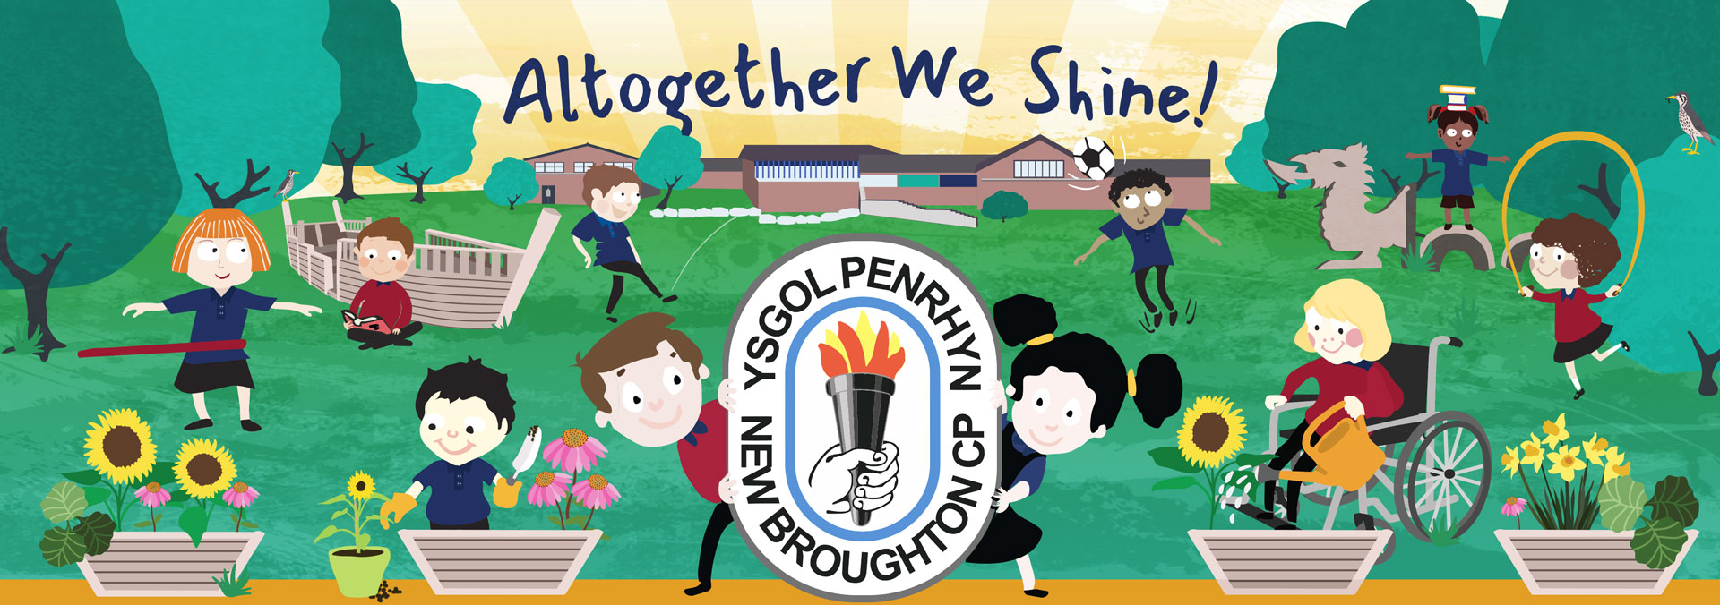
Our Vision and Values have been created together with our learners, staff, parents and Governors.
Ysgol Penrhyn celebrate and appreciate the Welsh language, culture and heritage during their time in school,
Our Vision
To create a safe, secure, happy and caring environment in which the children can grow and learn.
To recognise all children as individuals and motivate them to reach their full potential.
To work in partnership with families, Governors and local community, resulting in our children being confident, resilient and challenged to achieve their aspirations.
To provide our children with real life experiences and skills, equipping them with the confidence to face and overcome challenges to enjoy learning every day.
Values
Be kind and caring
Be happy and enthusiastic
Be creative and curious
Be honest and respectful
Be the best you can be

Slide 2

School Context
Our school strengths:
Established, experienced and highly committed staff.
Positive, nurturing environment with a warm, friendly atmosphere that helps well-being and engagement of both staff and pupils
Excellent at communicating with families and the community.
Nearly all pupils show kindness to their friends and are extremely welcoming to visitors. Staff set high expectations for pupils’ behaviour and nearly all behave well in classes and around the school.
Strong pupil voice to secure improvements in areas identified by peers
Pupils influence what and how they learn and engage in a broad, balanced and creative curriculum.
Staff know their children well and know how to help them succeed.
Our provision for pupils with ALN is well established and effectively implemented across the school.
Staff know the children and the community well.
There is a knowledge rich curriculum which supports pupils to become curious learners who are well acquainted with their local community, Wales and the wider world. Staff make good use of educational and residential visits to further enrich learning experiences.
Ysgol Penrhyn is proud to provide a safe, nurturing environment where all our learners can fulfil their maximum potential. We strive to give our learners real life learning opportunities, where they can improve their skills above and beyond their expectations, equipping them to realise there is a world of opportunities available to them.
Leaders, governors and staff work together diligently to ensure the school vision “Altogether we shine” is a lived experience that supports everyone to achieve more than they ever thought possible.

Slide 3

Progress against last year’s priorities 2024-25
Improve parental support for the progress of their children, by supporting learning at home, improving attendance and promoting the positive attitude towards school / learning
Many families have engaged with a range of child-centred activities, facilitated by outside agencies, this has improved family – school engagement.
Whole school attendance has increased this year, compared to last year. We are 1.8% above the national average.
Bronze award for myHappyMind has been accredited, as a result of the Well-Being Ambassadors promoting the parent App and organising a range of well being activities / fundraising.
2) Improve the impact of Governors on self-evaluation activity across school, as critical friends able to make sound and objective judgements about progress and the performance of the school
A majority of Governors have been actively involved in monitoring and supporting the implementation of school policies and are becoming more confident in their role as a critical friend
Nearly all Governors have completed training, as a result have improved their understanding of school processes.
3. Create learning opportunities for pupils to lead their own learning and skill development, as regular and continuous part of provision in and outside the classroom, across the whole school
Most learners make good progress in developing their mathematical knowledge and understanding, as a result of monitoring, evaluation and training
Nearly all pupils use a range of digital devices confidently and older pupils develop a range of skills, such as coding well
There are frequent opportunities for pupils to use the outdoor areas purposefully. Through Forest School, all pupils have beneficial opportunities to enrich their learning including those with emotional needs.
There is a strong commitment to raise the profile of Welsh throughout the school. Most staff are good Welsh language role models for pupils. The Criw Cymraeg raise awareness of Welsh culture through assemblies and encourage the use of Welsh around the school. Nearly all pupils have a positive attitude towards the Welsh language and culture.
4. Ensure all learners successfully access challenging learning opportunities across the whole school through targeted interventions and teaching.
Teachers and skilled support staff deliver targeted interventions that are carefully matched to pupils individual needs.
Staff and parents meet regularly to review interventions and monitor progress to ensure they are successful in enabling pupils to achieve their best at their stage of development.

Slide 4

School Priorities 2025-26
Ensure that monitoring, evaluation and improvement processes focus sharply on the aspects in most need of improvement
Strengthen curriculum planning and provision to support pupils to develop their skills progressively over time

